Slide 1
Introduction to Polymer
Freeze Period, 2017
Lukas Legters, Wesley Delpeut, Millitza Kroonenberg

Slide 2
Agenda
Time slot: 14.00-17.00
Topics
Introduction
Polymer vs. vanilla web components
Existing web components
Hands on: Create a Polymer web component
Setup a new Polymer project
Project case
Hands on: project case

Slide 3
Introduction

Slide 4


Introduction
Polymer
Wrapper for web components
Library

Slide 5
Polymer versions
2015
2016
2017
2018
Polymer 1.x
Polymer 2.x
Polymer 3.x
Web components v0 specs
HTML imports
Web components v1 specs
JS imports / ES modules
Lit HTML

Slide 6
“Use the platform”

Slide 7
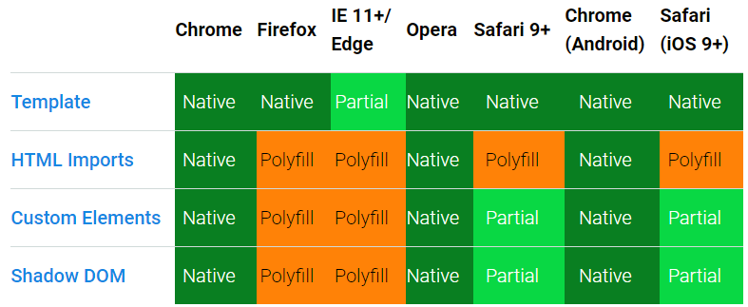
Browser support (14 December 2017)

Slide 8
Ways to use Polymer in your web application
Extend Polymer element
class MyElement extends Polymer.Element
Use existing web components

Slide 9
Polymer vs. vanilla web components

Slide 10
Polymer element <my-element />
<link rel="import" href="../bower_components/polymer/polymer-element.html">
<dom-module id="my-element"> <!-- Defines the element's style and local DOM --> <template> <style> :host { display: block; padding: 16px; } </style> <h1>Hello World</h1> </template> <script> // Your new element extends the Polymer.Element base class class MyElement extends Polymer.Element { static get is() { return 'my-element'; } // Now, register your new custom element so the browser can use it customElements.define(MyElement.is, MyElement); </script> </dom-module>

Slide 11
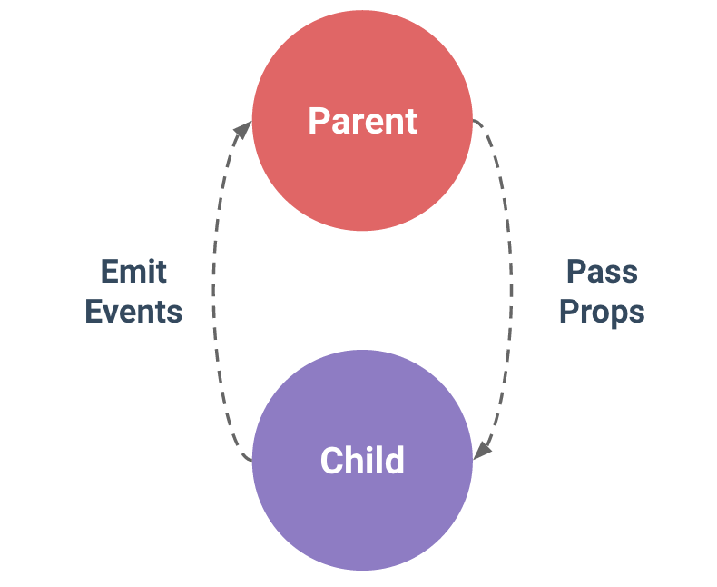
How does Polymer ease web development?
Data binding <my-element></my-element>
Polymer
Vanilla web component
<dom-module id="my-element"> <template> <h1>Hello [[name]]</h1>
<paper-input value=“{{name}}"/>
</template> </dom-module>
<template id="my-element"> <h1>Hello <span id="name"></span> </h1>
<paper-input id="nameInput"/>
</template>
<script>
class MyElement extends HTMLElement {
static get is() { return 'my-element'; }
constructor() {
super();
this.$.innerElement.addEventListener(‘name-
changed’, (e) => this.$.name.textContent =
e.detail.name;
}
}
</script>

Slide 12
How does Polymer ease web development?
Properties <my-element name=“Capgemini”></my-element>
Polymer
Vanilla web component
<dom-module id="my-element"> <template> <h1>Hello [[name]]</h1> </template> <script> class MyElement extends Polymer.Element { static get is() { return 'my-element'; }
static get properties() { return { name: String }; }
customElements.define(MyElement.is, MyElement);
} </script> </dom-module>
<template id="my-element"> <h1>Hello <span id="name"></span> </h1>
</template>
<script>
class MyElement extends HTMLElement {
static get is() { return 'my-element'; }
constructor() {
super();
}
static get observedAttributes() {
return['name'];
}
attributeChangedCallback(attribute, old, new) {
if (new != this[attribute]) {
this[attribute] new;
}
}
}
</script>

Slide 13
How does Polymer ease web development?
Style mixins
Polymer
<dom-module id="my-element"> <template> <style> .title { @apply --my-title-mixin } </style> <h1 class="title"> Hello World</h1> </template> <script> class MyElement extends Polymer.Element { static get is() { return 'my-element'; } customElements.define(MyElement.is, MyElement); </script> </dom-module>
<dom-module id="my-other-element"> <template> <style> :host { --my-title-mixin { color: green } } </style> <my-element />
</template> <script> class MyOtherElement extends Polymer.Element { static get is() { return 'my-other-element'; } customElements.define(MyOtherElement.is, MyOtherElement); </script> </dom-module>

Slide 14
Rebuild vanilla web component in Polymer

Slide 15
Existing components

Slide 16

webcomponents.org
Polymer elements
Paper elements: material design
Iron elements: core
App elements
Platinum elements: progressive web app
Gold elements: business
2) Other custom elements

Slide 17
Hands on: create a Polymer web component

Slide 18
Project case

Slide 19
Photo freeze
Single page application
Three functionalities:
Upload photo plus descriptive word & hint
Overview of photos to get and update photos
Photo Card to guess the descriptive word for one photo
Use Polymer

Slide 20
Setup our project

Slide 21
Create 3 groups
Do the exercises
Hands on: project case

